Slide 1
-:EMPLOPY MAGNAGEMENT SYSTEM:- B. Tech in CSE C-SEC TEAM NAME:S3AH
1. SHASHI KUMAR | 17ETCS002227
2.AKASH KUMAR | 17ETCS002230
3.SATYAM KUMAR | 17ETCS002233
4.SAMEER SINGHANIYA | 17ETCS002224
5.HIMANSHU GOWAL | 17ETCS002219

Slide 2
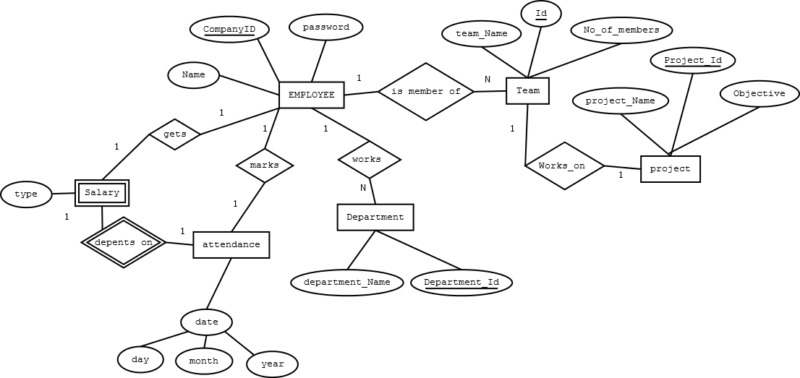
-:ER DIAGRAM:-

Slide 3
Functional requirement:
1. Attendance:
In this model the user is required to enter staff id, name, and password and click the register attendance to indicate his presence for that day.
2. course:
This model enable the user to manipulate and view the course details.
3. Department:
This model enable the user to manipulate and view the department details.

Slide 4
-:Data Requirement:-
Employee name
Login id and password
Team name
Number of members
Project id
Project name
Objective
Department name
Department id

Slide 5
Thank You

